Slide 1
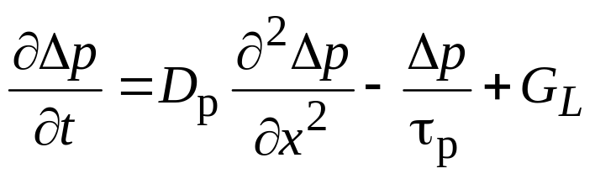
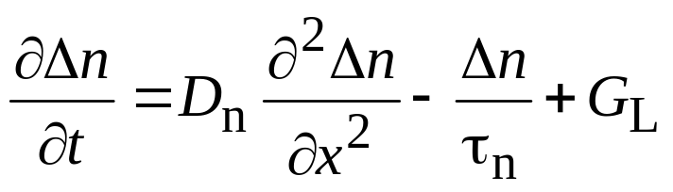
Chapter 11-1 Detailed Quantitative Analysis
The goal is to relate transistor performance parameters
(γ, α_{T} , β_{dc} etc. ) to doping, lifetimes, base-widths etc.
Assumptions:
pnp transistor, steady state, low-level injection.
Only drift and diffusion, no external generations
One dimensional etc.
General approach is to solve minority carrier
diffusion equations for each of the three regions:
and

Slide 2
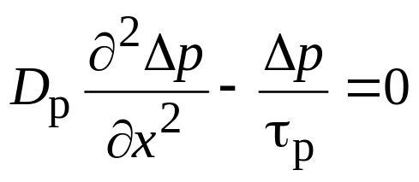
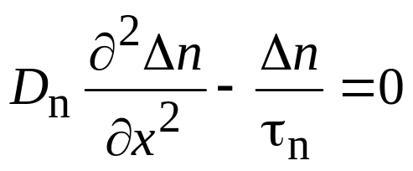
General Quantitative Analysis
Under steady state and when G_{L}= 0,
and
For the base in pnp, we are interested only in holes.
The rigorous analysis is carried out in chapter 11, but we are going to take a more simplified approach.

Slide 3





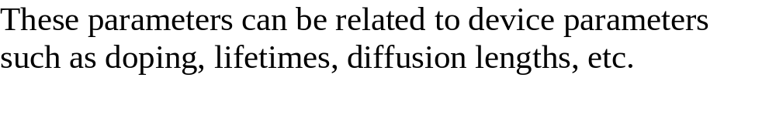
Review: Operational Parameters
I_{EP}
I_{BR}
–I_{EN}
–I_{BE}
–I_{BR}
Injection Efficiency :
Base transport factor : α_{T} = I_{C} / I_{EP}
Collector to emitter current gain: α_{DC} = α_{T} γ
Collector to base current gain: β_{DC} = α_{DC} / (1 – α_{DC})

Slide 4
Review: Indirect thermal recombination-generation
n₀, p₀ – under thermal equilibrium
n, p – under arbitrary conditions, functions of t
Δn = n – n₀
Δp = p – p₀
Low-level injection condition is assumed.
  Change in the majority carrier concentration is negligible.
  For example, in n-type material, Δp << n₀ ; n ≈ n_{0.}
  in p-type material, Δn << p₀ ; p ≈ p_{0.}
Δn and Δp are deviations in carrier concentrations from their equilibrium values. Δn and Δp can be both positive or negative. Δn and Δp are termed excess carriers – excess above the equilibrium concentration.
Majority carriers are electrons in n-type material and holes in p-type material.

Slide 5
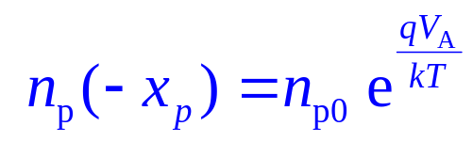
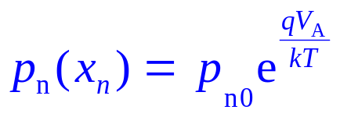
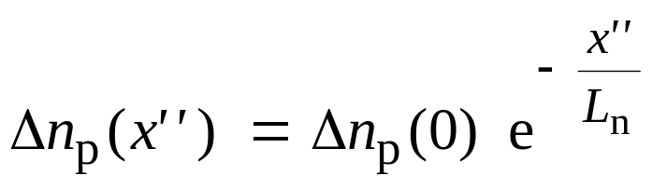
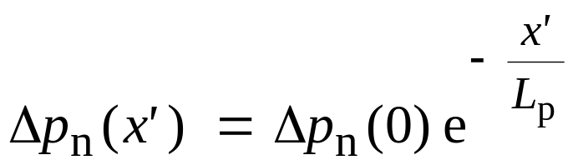
Review: Minority carrier concentration profile under bias
p-side
n-side
+ V_{A} −
Δn_{p}(0)
Δp_{n}(0)
n_{p}= n_{p0} +Δn_{p}(x'')
p_{n} = p_{n0} + Δp_{n}(x')
p_{n0}
n_{p0}
x''
x'

Slide 6
Review of P-N Junction Under Forward Bias
+ V_{EB} −
Δn_{E}(0)
Δp_{B}(0)
p-type (emitter)
n-type (base)
Area = Q_{p}
Area = Q_{n}
p_{B0}
n_{E0}
x_{E}
x_{B}
0
0

Slide 7
Review of P-N Junction Under Forward Bias (cont.)
I_{n} = q A D_{E} dΔn/dx_{E} = – (q A D_{E}/L_{E}) Δn_{E}(0)
I_{p}= – q A D_{B} dΔp/dx_{B} = (q A D_{B}/L_{B}) Δp_{B}(0)
Total current
I = I_{P} + (– I_{N}) (“–” because x_{E} and x_{B} point in opposite directions)
= (q A D_{B}/L_{B}) Δp_{B}(0) + (q A D_{E}/L_{E}) Δn _{E} (0)
= (q A D_{B}/L_{B}) p_{B0} [ exp (q V_{EB} / kT) – 1 ] +
+ (q A D_{E}/L_{E}) n_{E0} [ exp (q V_{EB} /kT) – 1 ]
≈ (q A D_{B}/L_{B}) p_{B0} exp (q V_{EB}/kT) + (q A D_{E}/L_{E}) n_{E0} exp (q V_{EB}/kT)
Note: I_{p} and I_{n} can also be calculated based on the fact that Q_{p} has to be replaced every τ_{B} seconds
➔ I_{p} = Q_{p}/τ_{B} and I_{n} = Q_{n}/τ_{E} and I_{E} = I_{P} + I_{N}

Slide 8
Simplified Analysis
Consider the carrier distribution in a forward active pnp transistor
Emitter
Base
Collector
p_{B}(0)
n_{E}(0)
n_{C0}
n_{E0}
p_{B0}
n_{C}(0)

Slide 9
Simplified Analysis (cont.)
E
(p⁺)
B
(n)
C
(p)
n_{E0}, p_{B0} and n_{C0} = equilibrium concentration of minority
carriers in emitter, base and collector
n_{E}(0), p_{B}(0) and n_{C}(0) = minority carrier concentration under forward active conditions at the edge of the respective depletion layers
Δn_{E} (0), Δp_{B}(0) and Δn_{C}(0) = excess carrier concentration at the edge of the depletion layers

Slide 10
Simplified Analysis (cont.)
Δn_{E} (0) = n_{E} (0) – n_{E0} = n_{E0} [exp (q V_{EB} / kT) – 1]
Δp_{B} (0) = p_{B} (0) – p_{B0} = p_{B0} [exp (q V_{EB} / kT) – 1]
By taking the slopes of these minority carrier distribution at the depletion layer edges and multiplying it by “q A D_{n,p}”, we can get hole and electron currents.
Note that I_{n} = q A D_{n} (dn / dx) and I_{p} = – q A D_{p} (dp / dx)

Slide 11
Calculation of Currents
    Collector current, I_{C}
    I_{C} = q A D_{B} (dp/dx_{B}) (slope must be taken at end of base)
    = q A D_{B} [p_{B}(0) – 0] / W_{B}
    = q A D_{B} p_{B}(0) / W_{B}
    I_{C} = q A (D_{B}/W_{B}) p_{B0} exp (qV_{EB} / kT) ---- (A)
    (only hole current if we neglect the small reverse saturation current of reverse biased C-B junction)

Slide 12
Calculation of Currents (cont.)
  Emitter Current, I_{E}
I_{E} is made up of two components, namely I_{EP} and I_{EN}
I_{EP} = I_{c} + current lost in base due to recombination
= I_{c} + excess charge stored in base/τ_{B}
= I_{c} + q A W_{B} Δp_{B}(0) / (2τ_{B})
≈ q A (D _{B}/W _{B}) p_{B0} [exp (qV_{EB} / kT) ] +
+ q A [W _{B}/(2τ_{B})] p_{B0} [exp (qV_{EB} / kT)] ---- (B)
[ Assuming exp (q V_{EB} / kT) – 1 ≈ exp (q V_{EB} / kT)
when V_{EB} is positive, i.e forward biased ]

Slide 13
Calculation of Currents (cont.)
Emitter Current (cont.)
  I_{EN} corresponds to electron current injection from base to emitter since E-B junction is forward biased.
I_{EN} = q A (D _{E} / L_{E}) n_{E0} [exp (q V_{EB} / kT) – 1 ]
≈ q A (D _{E} / L_{E}) n_{E0} [exp (q V_{EB} / kT)] ---- (C)

Slide 14
Calculation of Currents (cont.)
Base Current, I_{B}
    supplies electrons for recombination in base
    supplies electrons for injection to emitter
    I_{B} = q A p_{B0} [W_{B} / (2τ_{B} )] [exp (qV_{EB} / kT) ]
    +
    q A (D _{E} / L_{E}) n_{E0} exp (qV_{EB} / kT)
    ( recombination) + (electron injection to emitter)
    Now we can find transistor parameter easily.

Slide 15
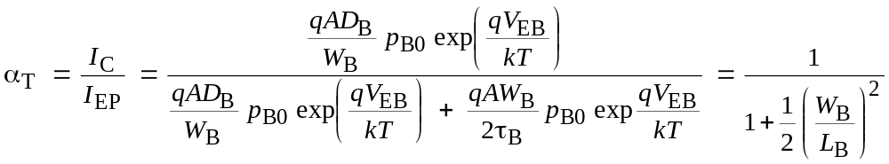
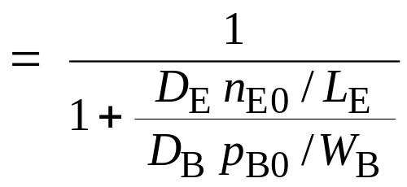
Calculation of Currents (cont.)
Base transport factor, α _{T}
(same as eq. 11.42 in text)
Emitter injection efficiency, γ
γ = I_{EP} / [ I_{EP} + I_{EN} ] = 1 / [ 1 + I_{EN} / I_{EP} ]
= 1 / [ 1 + (C) / (B) ]

Slide 16
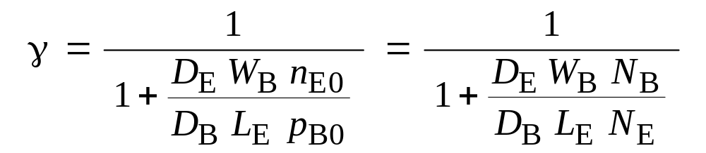
Calculation of Currents (cont.)
(Eq 11.41 in textbook)
➔ n_{E0 =} n_{i} ² / N_{E} … doping in emitter
➔ p_{B0 =} n_{i} ² / N_{B} … doping in base
α_{dc} = γ α_{T}
β_{DC} = α_{DC} / (1– α_{DC} )

